Slide 1


VTS Training Day
Tuesday 6th June 2023
www.janusconsultancy.com
Janus Consultancy is authorised and regulated by the Financial Conduct Authority, FCA number: 529609

Slide 2
The NHS Pension Scheme (2015)
Pension based on 1/54th of “revalued pensionable pay”
  (total career pensionable earnings increased per annum by Treasury Orders + 1.5%)
The employer contributes 14.38%
Option to take some as a tax-free lump sum
Life Insurance
Income Protection - limited
Inflation proofed

Slide 3
The Cost
Pensionable Salary 2022/23 | Cost
£0 - £13,246.99 | 5.1%
£13,247.00 - £16,831.99 | 5.7%
£16,832.00 - £22,878.99 | 6.1%
£22,879.00 - £23,948.99 | 6.8%
£23,949.00 – £28,223.99 | 7.7%
£28,224.00 - £29,179.99 | 8.8%
£29,280.00 - £43,805.99 | 9.8%
£43,806.00 - £49,245.99 | 10.0%
£49,246.00 - £56,163.99 | 11.6%
£56,164.00 - £72,030.99 | 12.5%
£72,031.00 + | 13.5%
Grade | Pensionable Salary* | Cost per annum (before tax relief) | Cost per month (before tax relief) | Cost per month (after tax relief)
F1 | £29,384 | £2,879.63 | £239.97 | £191.97
F2 | £34,012 | £3,333.18 | £277.76 | £222.21
ST3/CT3 | £51,017 | £5,917.97 | £493.16 | £382.99
*Figures taken from the NHS Pay and Conditions Circular (M&D) 30/03/2023.

Slide 4
Early Retirement
Age | 67 | 66 | 65 | 64 | 63 | 62 | 61 | 60 | 59 | 58 | 57 | 56
Pension | 6% | 11% | 16% | 20% | 24% | 27% | 31% | 34% | 37% | 40% | 43% | 45%
Retiring early could reduce your pension entitlement to the equivalent of a Foundation Year Junior Doctor’s income
Most Doctors will not be able to retire at 55
    A wish of the past . . . . . . .

Slide 5
2015 Scheme
 | 2015 Scheme
Accrual Rate | 1/54th for each year’s service
Based on | Revalued Pensionable Earnings (Average pay of pensionable career increased per annum by Treasury Orders* + 1.5%)
Retirement Age | State Pension Age
*Treasury Orders are the method by which the Treasury notifies the value of change in prices or earnings to be applied as part of revaluation.

Slide 6
Why have a Retirement Plan?
Tax free benefit at your taxable rate
 | Total (Gross) Payment | Basic Rate Relief | Higher Rate Relief* | Actual (Net) Payment | Equivalent Rate of Return
Basic Rate Taxpayer | £100 | £20 | £0 | £80 | 25%
Higher Rate Taxpayer | £100 | £20 | £20 | £60 | 66%*
*Due to being a higher-rate tax payer, the amount actually paid out by an individual grows by 66%

Slide 7
Available ways to increase your Retirement Fund
Buy Additional Pension from the NHS
    Up to £6,500 per annum additional pension
In house additional voluntary contribution (Stocks & Shares)
Personal Pension contribution (Stocks & Shares)
Equity Individual Savings Account (Stocks & Shares ISA
Lifetime ISA (LISA)
Early Retirement Reduction Buy Out (ERRBO)

Slide 8
Don’t leave it too late
….it’s too expensive
£147 per month for a 25 year old Doctor over 30 years will achieve a fund of £100,000.
      In order to reach a fund value of £100,000, one would have to contribute the following amounts dependent on age.
Age | Monthly contribution | Total contributions | Cost of delay
25 | £159 | £57,240 | £0
30 | £211 | £63,300 | £6,060
35 | £291 | £69,840 | £12,600
40 | £428 | £77,040 | £19,800
*Assuming one invests in a pension plan to age 55, at an assumed return of 5% per annum. Data derived from O&M Systems Pension Profiler 01/06/2023

Slide 9
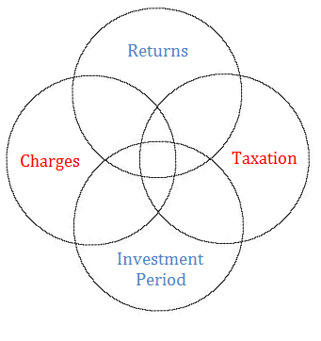
Savings & Investments

Slide 10
Savings & Investments
Charges
Expected Returns Low Charge (0.99%)* | Expected Returns Mid Charge (1.25%)* | Expected Returns High Charge (1.57%)*
£42,900 | £42,300 | £41,600
*Assuming one invests in an ISA plan for 10 years, paying in £300 per month which then grows at an assumed 5% per annum growth rate. Data derived from Funds Network Platform on 01/06/2023.

Slide 11
Savings & Investments
Taxation
Product | Amount per month | Low Growth | Mid Growth | High Growth
ISA Investment | £100 | £11,600 | £13,500 | £15,800
Non-ISA Investment | £100 | £11,300 | £13,200 | £15,400
*Data derived from Funds Network Platform where the ISA is projected at 2,5 & 8% and the non-ISA at 1.5, 4.5 & 7.5% as recommended by the FCA. The term of the investment was set at 10 years and data was correct on 01/06/2023

Slide 12
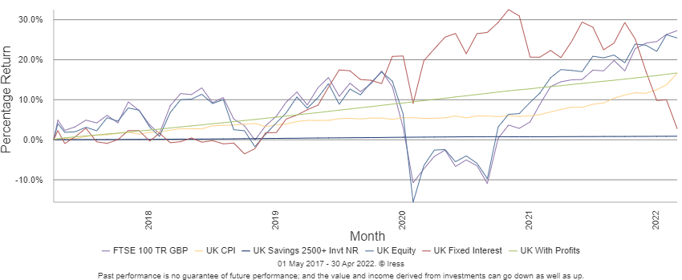
Savings & Investments
Returns

Slide 13
Savings & Investments
Investment Period
          Target amount: £24,000 to age 40
Age | Monthly contribution | Total contributions | Cost of delay
25 | £98 | £18,000 | £0
30 | £165 | £20,000 | £2,000
35 | £365 | £24,200 | £6,200
*Assuming one invests in an ISA plan to age 40, at an estimated return of 5% per annum. Data derived from O&M Systems ISA Profiler on 01/06/2023

Slide 14
Protection
NHS Income Protection
Length of Service Completed | Full Pay Expected | Half Pay Expected
Year 1 | 1 month | 2 months
After 1 year | 2 months | 2 months
After 2 years | 4 months | 4 months
After 3 years | 5 months | 5 months
After 4 years | 5 months | 5 months
After 5 years | 6 months | 6 months

Slide 15
Long-term Income Protection
Reviewable vs. Guaranteed Premiums
 | Monthly contribution | Monthly Benefit
Reviewable | £27.68 | £2,201
Guaranteed | £29.82 | £2,201
*Figures derived from The Exchange Comparison Service on 01/06/2023 and cover to age 65 without indexation.

Slide 16
Is it cheaper to wait?
Age | Monthly contribution | Total contribution | Monthly Benefit
28 | £29.82 | £13,238 | £2,201
38 | £47.68 | £14,869 | £2,201
*Figures derived from The Exchange Comparison Service on 01/06/2023 and cover to age 65 without indexation

Slide 17
The Financial Advisory Industry
Independent Financial Advice
‘Restricted’ Financial Advice

Slide 18
Cost of Advice
-
The Government made changes in January 2013 to make clients pay for financial advice. We aim to ensure that such advice is not limited to the wealthy
Free First Meeting
          To assess and draw a financial plan to set up the goals you wish to achieve in the short, middle and long-term.
We will not charge you for protection or mortgage advice
          e.g. income protection, life insurance, residential or buy to let mortgages
Should there be any charges, we will discuss these upfront with you.

